Slide 1

Streamline Annual Document Reviews with Power Apps
Heidi Jordan

Slide 2
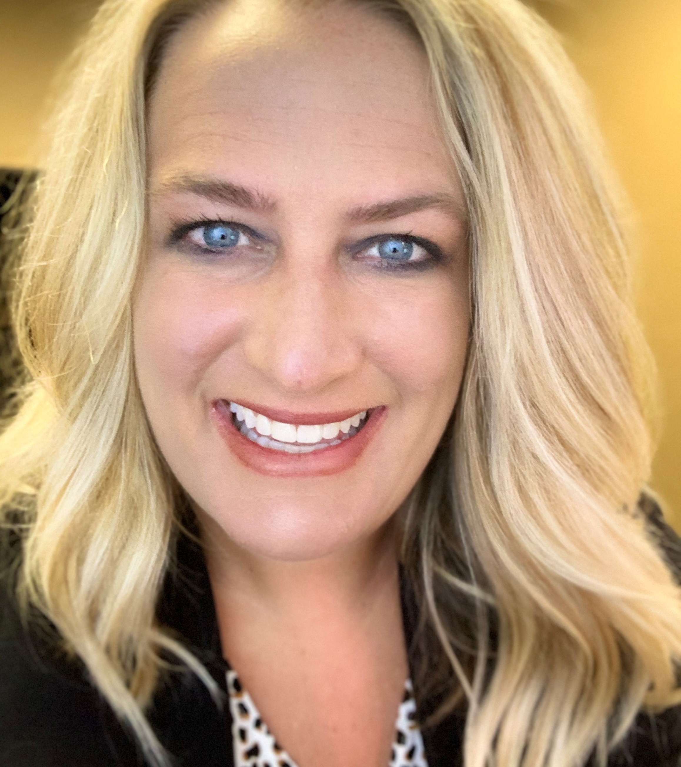
About Me
Heidi Jordan – Sioux Falls, SD
SharePoint Solutions Specialist – High Plains Technology
Fluent in SharePoint On-Premises, SharePoint Online, InfoPath, SharePoint Designer, Power Apps, Power Automate
Twitter: @heidi_jordan14 | Blog: Heidi-Jordan.com | LinkedIn: Heidi Jordan
Notes:
I’m a SharePoint person finding my way in a Power Platform world. Aspiring speaker & blogger. I’ve been a consumer of Community content for years (conferences, podcasts, blogs, etc. ) and I’m sick of sitting on my knowledge – I’m ready to be a producer. The community has had a tremendous impact on my life and career and I’m hoping to have the same effect on others.

Slide 3

Annual Policy Reviews
Where is that spreadsheet with all the policies listed?
Is this the latest approved version of the policy?
Who is responsible for reviewing this policy?
Can I spread these out a bit, so I don’t bombard one person with too many reviews this month?
Is there an easier way to remind them to complete their review?
Does this policy require committee approval?
How do we track the outcome?
Can I get a report of all policies reviewed in the last year?
Notes:
I work with a lot of financial institutions and bank regulations mandate centrally accessible policies and procedures for staff. Everything from severe weather procedures to Reg Z (truth in Lending). To ensure banks remain compliant, these documents need to be reviewed on a set schedule.
For example, annually for policies. Generally, an organization will have these all stored in a fileshare – maybe on an All drive. Then to track reviews, they maintain a list of policies in Excel and track owner, review dates, etc. Link to the document location on the fileshare.
Reviews were being missed – nothing to alert users of upcoming dates
Reviews sent via email including reminders/follow up.
Need to ensure the latest version of the document is reviewed and also track revisions
Produce a report with review dates for auditors
Overall a very manual process.

Slide 4

Is Power Apps the appropriate technology for the process?
Sit down with the people who are working this process every day.
1
Talk them through their current process.
2
Ask them describe their ideal process.
3
Map out the process.
4
Notes:
Now that we know the problem – we can look at using Power Apps as a possible solution.
Steps:
1. The stakeholders are generally the reason you’re having the meeting in the first place – they’ll get you in the door and then you’ll be working with the users who will be maintaining your solution.
Remember to keep this conversation about the process, not the technology.
2. Shoot for their ideal state process and step your way down from there. Remember the things that users may tend to overcomplicate – ex. Yes we can create a process to accommodate that but how often does that actually happen and could your work around be sufficient?

Slide 5
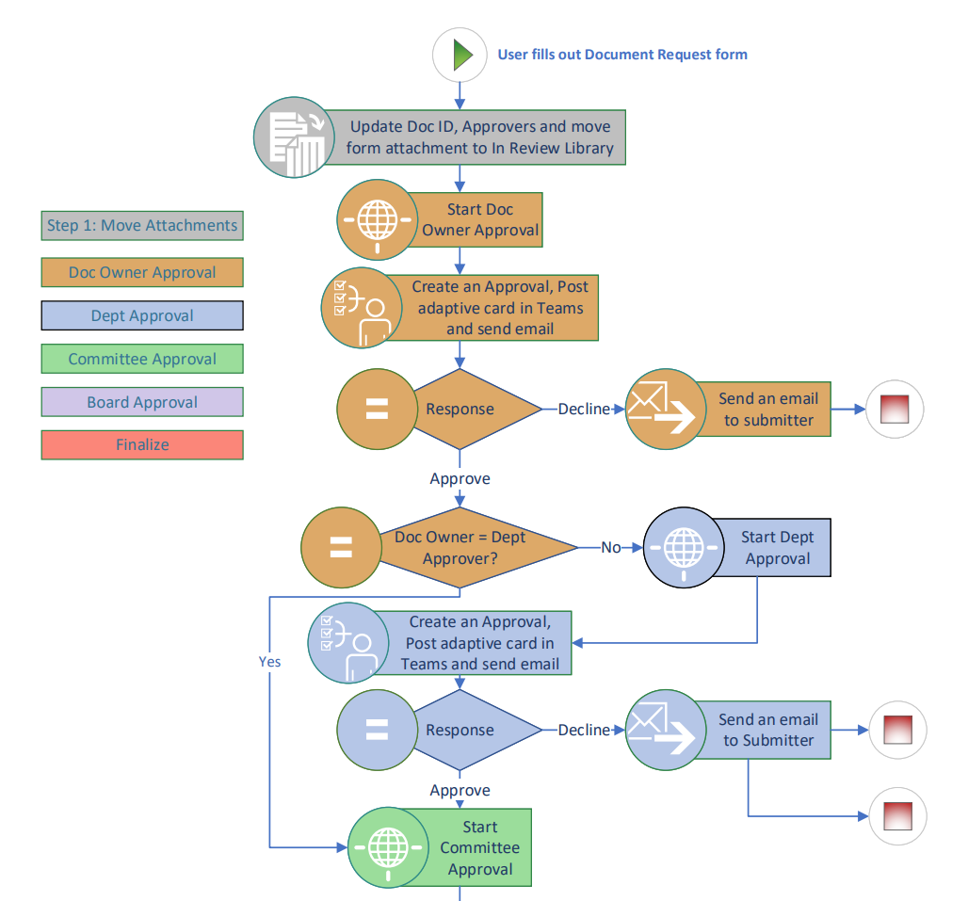
Sample Approval Process
Notes:
Sometimes I take the backwards approach – if you can determine what needs to be collected/approved, then you know what you need to put on your form.
A visual helps users follow along in their process – it’s possible they’ve never mapped this out before and their process was derived from “just doing it” or learning from someone else.
In this case, we determined that there were 4 levels of approval that were needed, signified by the different colors. TIP: Each color is different flow – the whole process is comprised of 6 flows but by breaking it up, you can restart the approval process from a certain step.

Slide 6
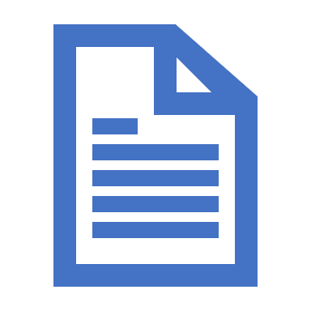
Demo
Policy Revision Request Form
Form Filtering
Attachments
Form Design
Notes:
I’d like to demo a few features of this solution, just to show what’s possible. There’s details lacking on the actual process for the sake of time.

